Slide 1
Stop Motion Animation Workshop
UK Primary School
Friday 25th June 2021

Slide 2
How to turn your story into a film . . .

Slide 3
Your story plan probably looks a bit like this . . .
Crops growing in a field

Slide 4
Or something more complicated?
What are your stories about?

Slide 5
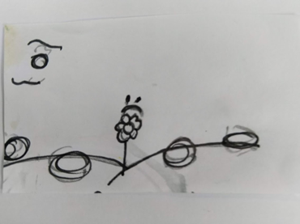
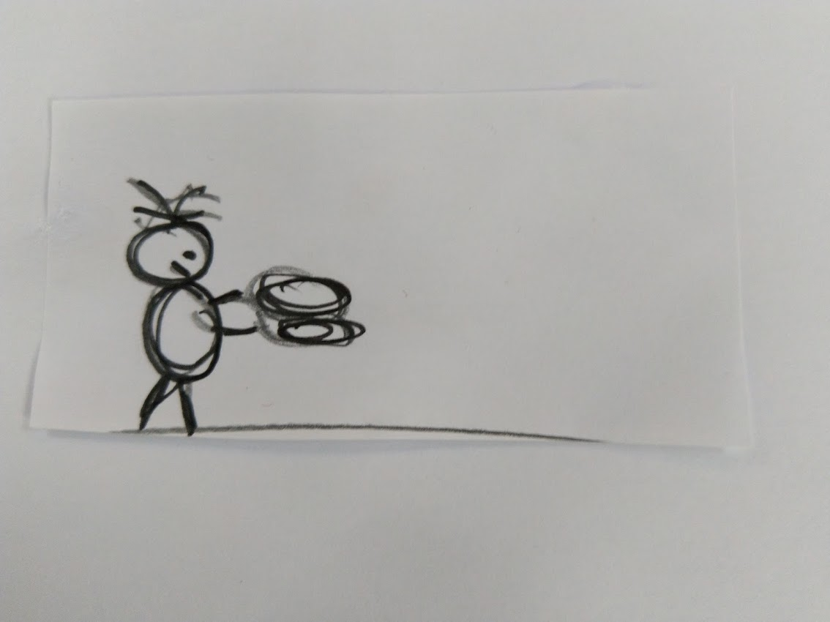
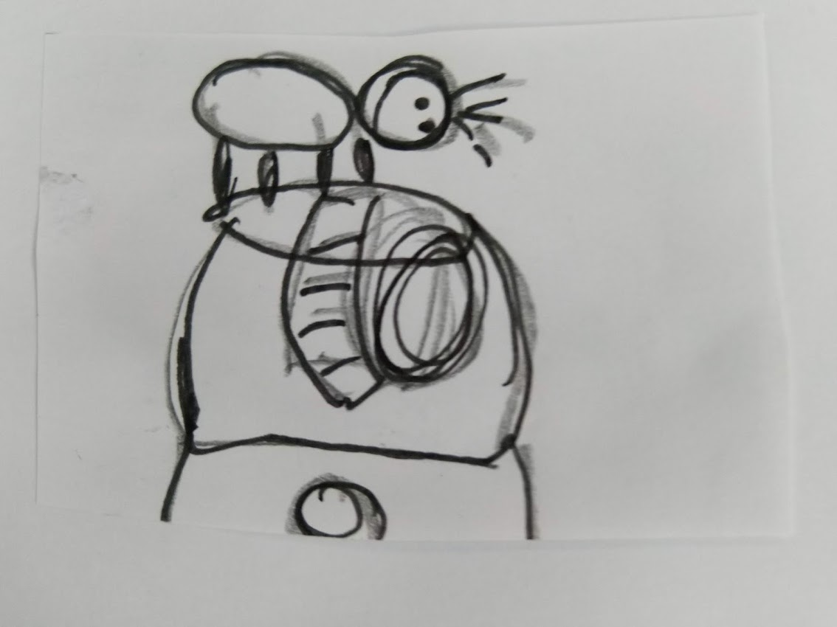
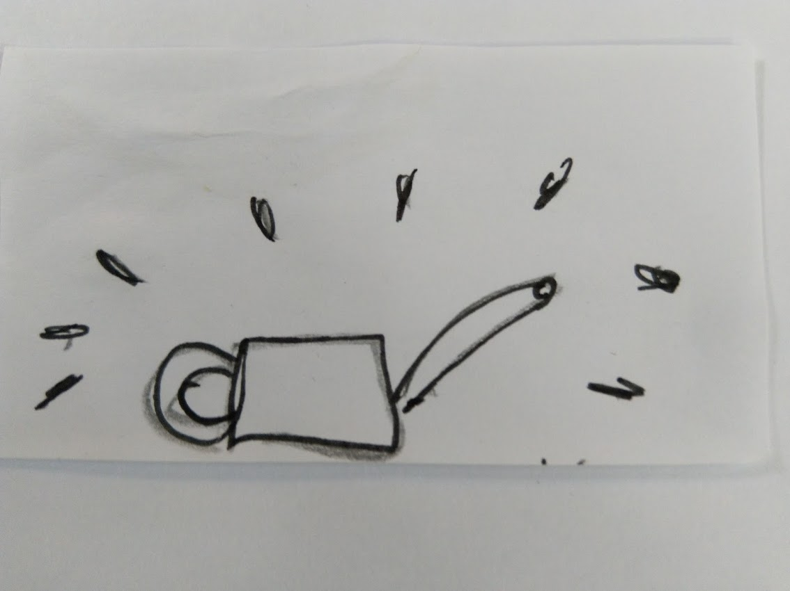
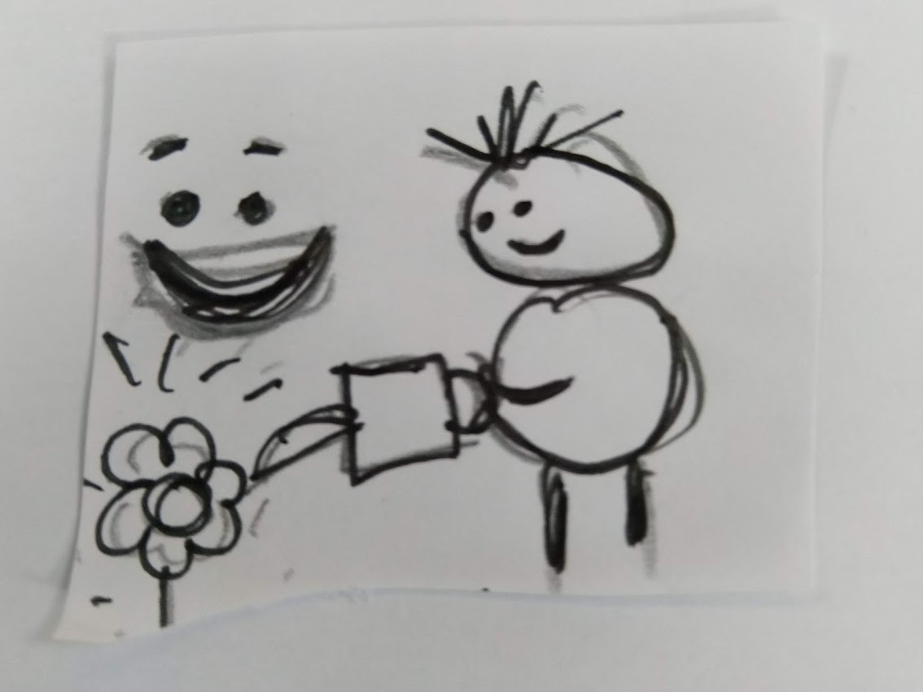
1. Rubbish (bottle lids) are polluting a field. Nature (a sunflower) is unhappy. | 2. Two children arrive. They collect the bottle lids. | 3. They take them to a recycling plant and meet the recycling man.
4. He takes them to the recycling machine it makes a watering can (a useful product). | 5. ? The children take the watering can back to the field and give it to another child. | 6. The child waters the sunflower and Nature is happy.

Slide 6
So what do you do first?
Look at your story – how many characters do you have?
What props do you need?
What can you use to make them?

Slide 7
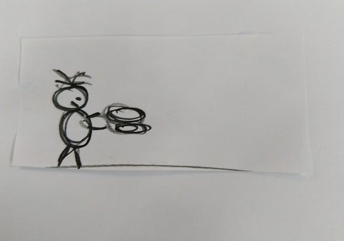
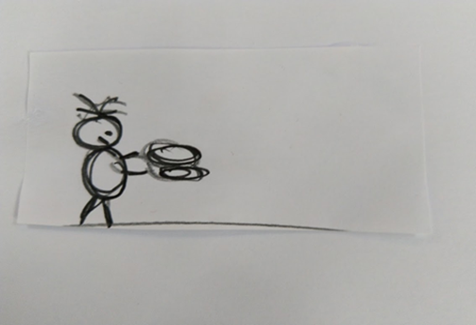
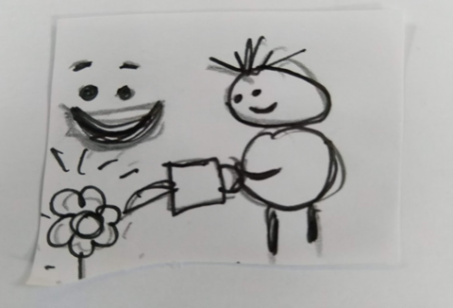
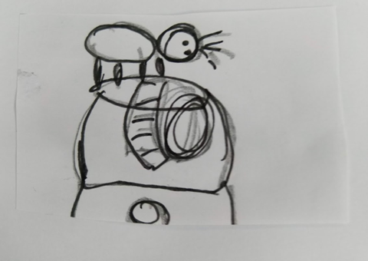
We started with the characters . . .
Three children
One recycling man

Slide 8
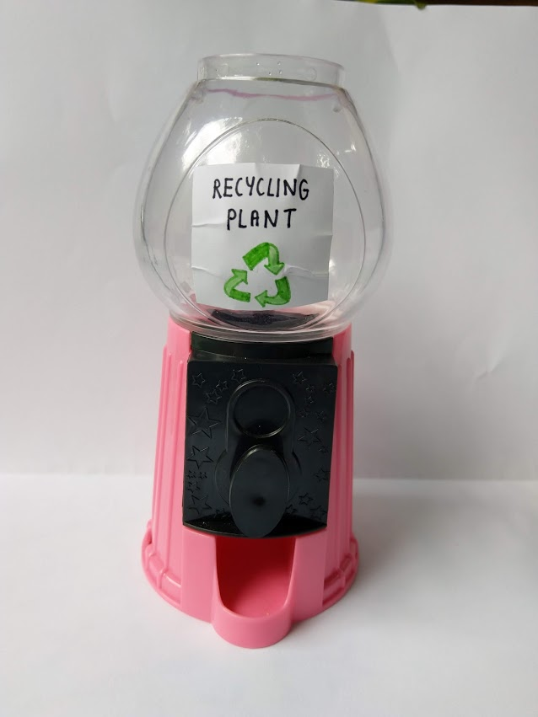
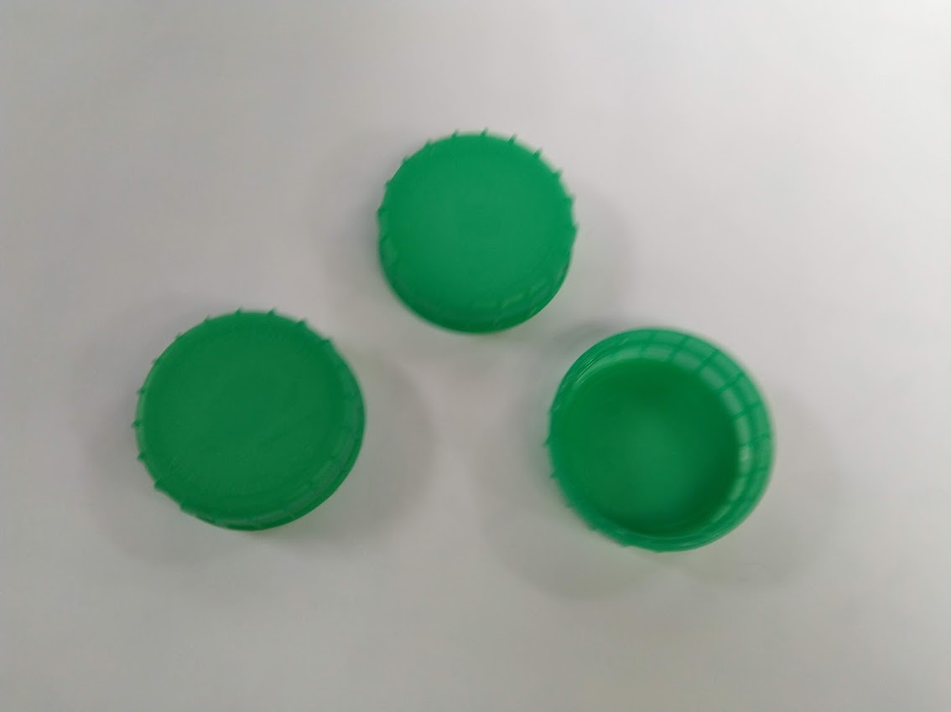
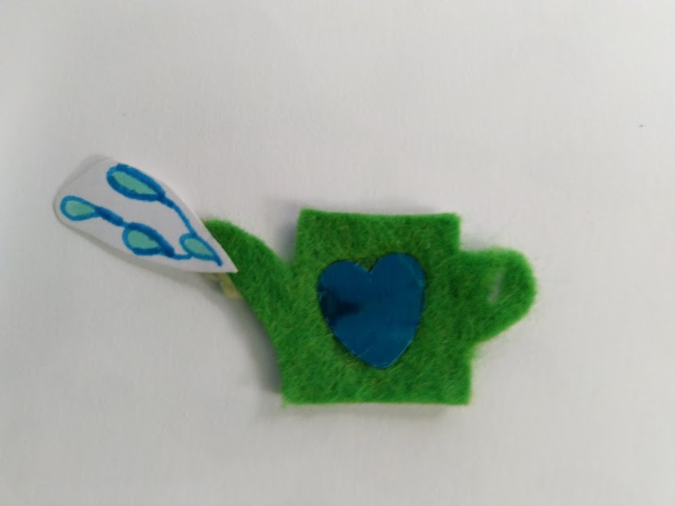
We thought about the props . . .
A recycling machine
Plastic bottle tops
A watering can

Slide 9
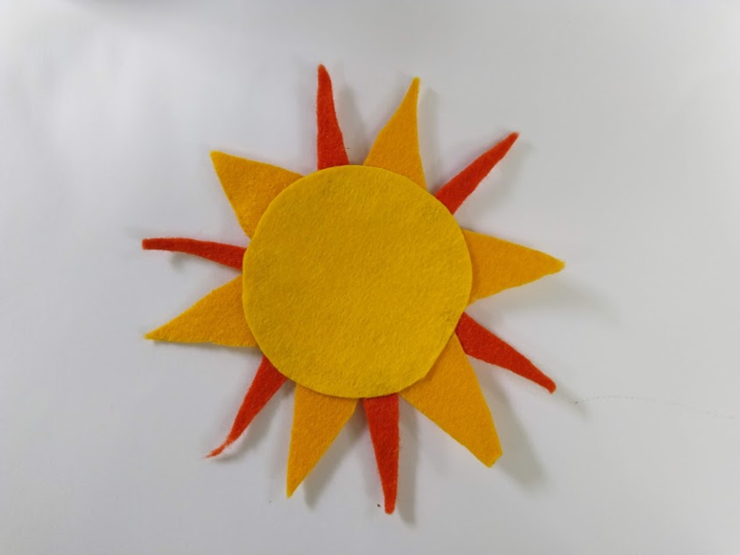
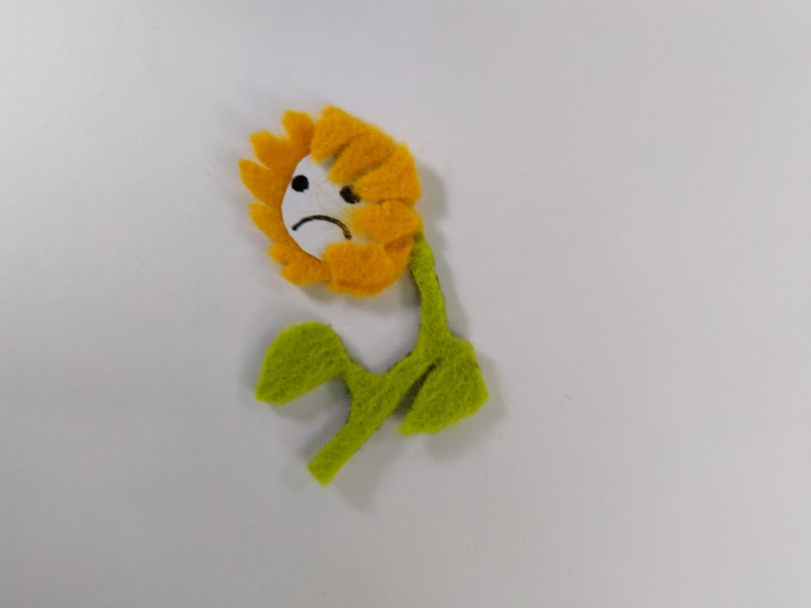
We thought about other props . . .
A sun
A sunflower

Slide 10
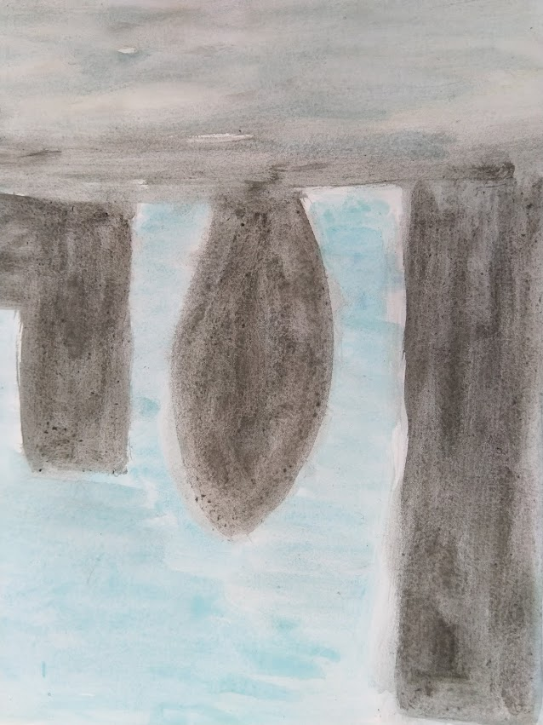
We thought about things we could not make but we could paint, like backdrops . . .

Slide 11
And we added the props to the backdrop . . .

Slide 12
We made some people . . .

Slide 13
And we made a short film . . .

Slide 14
And we added sound . . .

Slide 15
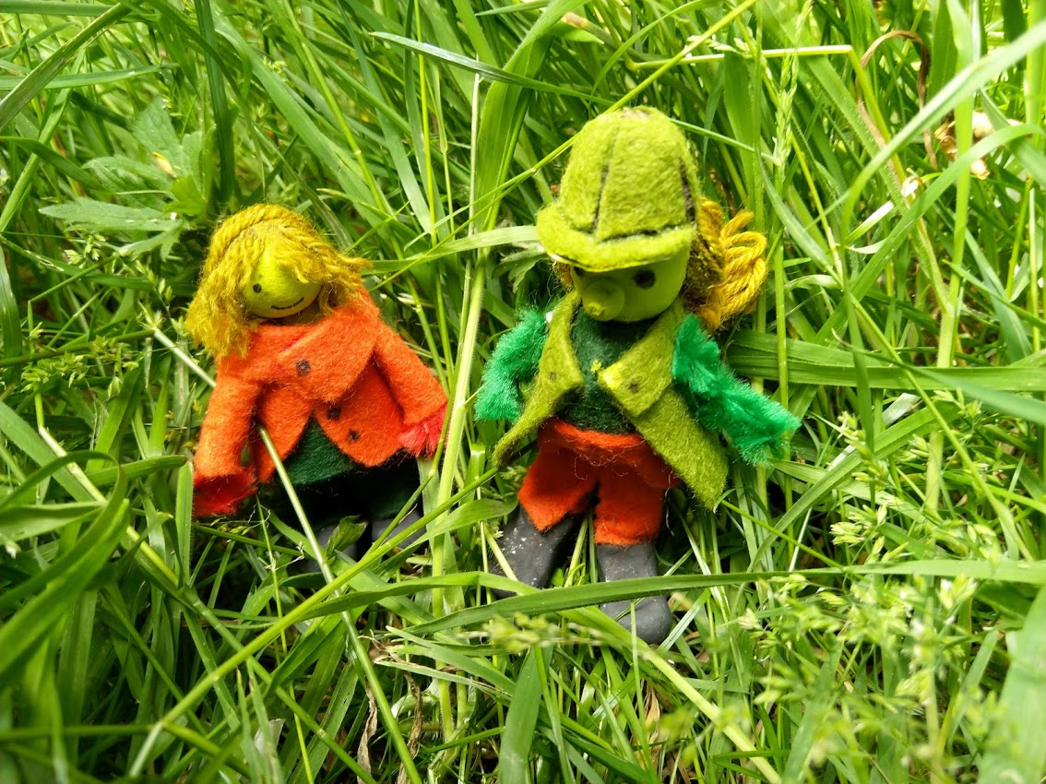
And we decided we needed titles and credits . . .
BUT for the program you are using, titles HAVE TO BE FILMED BEFORE THE FILM ! ! !
Oh dear!
So we made a new film and
filmed it outside.

Slide 16
Farming Film

Slide 17
But we missed something! What should come next?

Slide 18
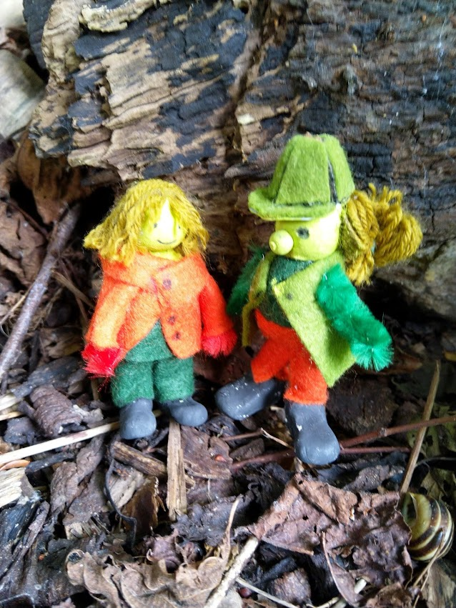
For the audio . . .
We made some music.
We wrote a script.
We recorded music and narration
together in ONE take.

Slide 19
If you are filming outside . . .
You MUST pick a clean, safe place – check for anything that looks dirty or dangerous and show your teacher.
When your teacher says the place is safe, think about how you can position your characters and your props.
Practice your story A LOT before you start filming.
Think very carefully about what you touch, if you are not sure check with your teacher.
ALWAYS wash your hands as soon as you go back inside.

Slide 20
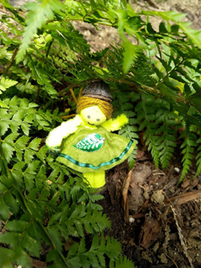
For the film-making you will need to follow these instructions . . .
Tap Stop Motion Studio in apps.
Tap New Movie.
Tap red button to take a shot, move an object, take another shot, move an object, take another shot . . .

Slide 21
Let’s do a demo of filming . . .

Slide 22
Let’s do a demo of recording sound . . .

Slide 23
What we learned . . .
You need AT LEAST two people – one to film and one to move objects.
Five frames make one second so to make a shining sun you could make four suns and interchange them.
A 5 second film is 25 frames and that takes about 5 minutes to make.

Slide 24
A shining sun . . .

Slide 25
This is actually FOUR suns . . .

Slide 26
A shining sun . . .

Slide 27
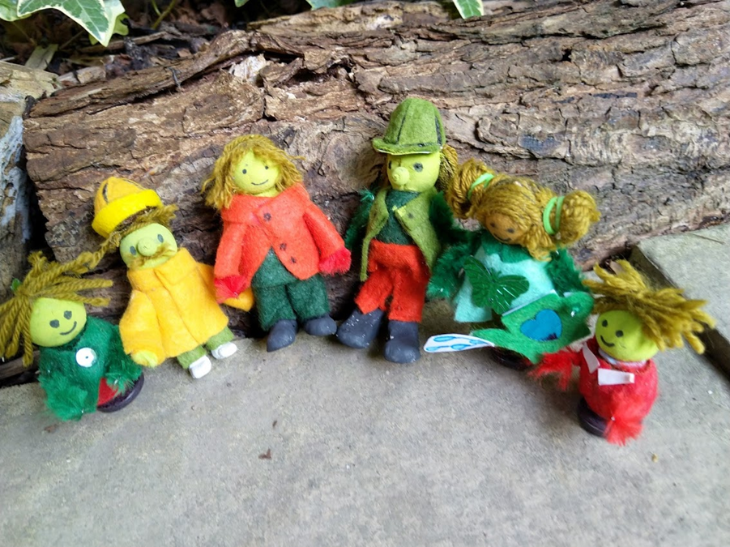
Saving your film is more complicated and your teacher will have these instructions.

Slide 28
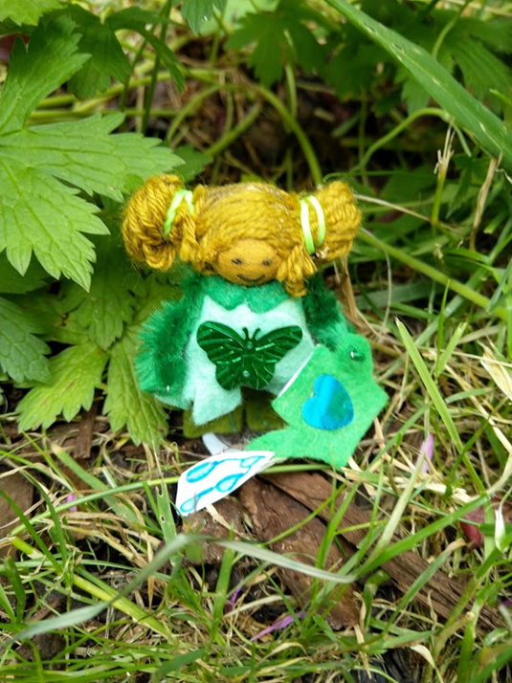
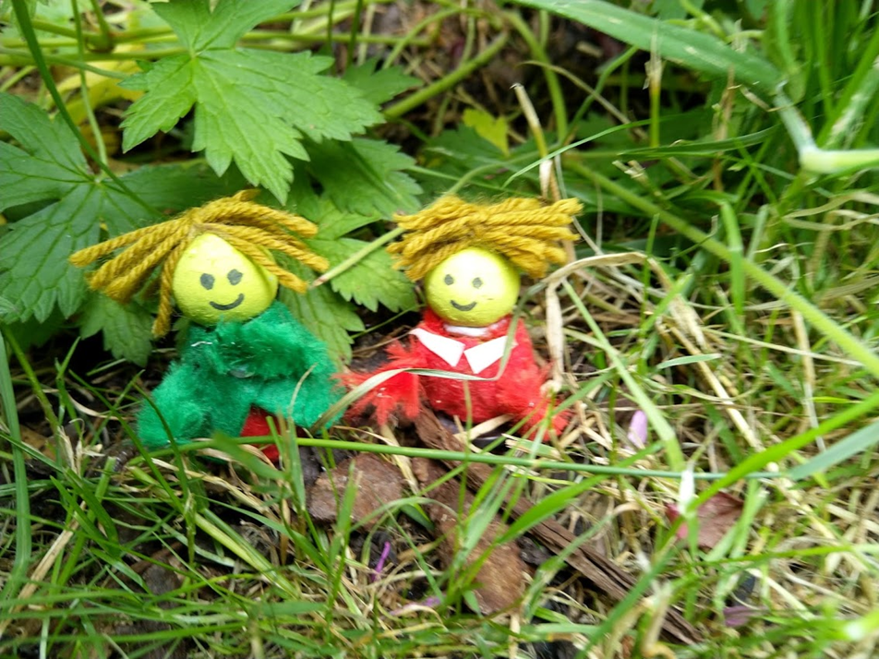
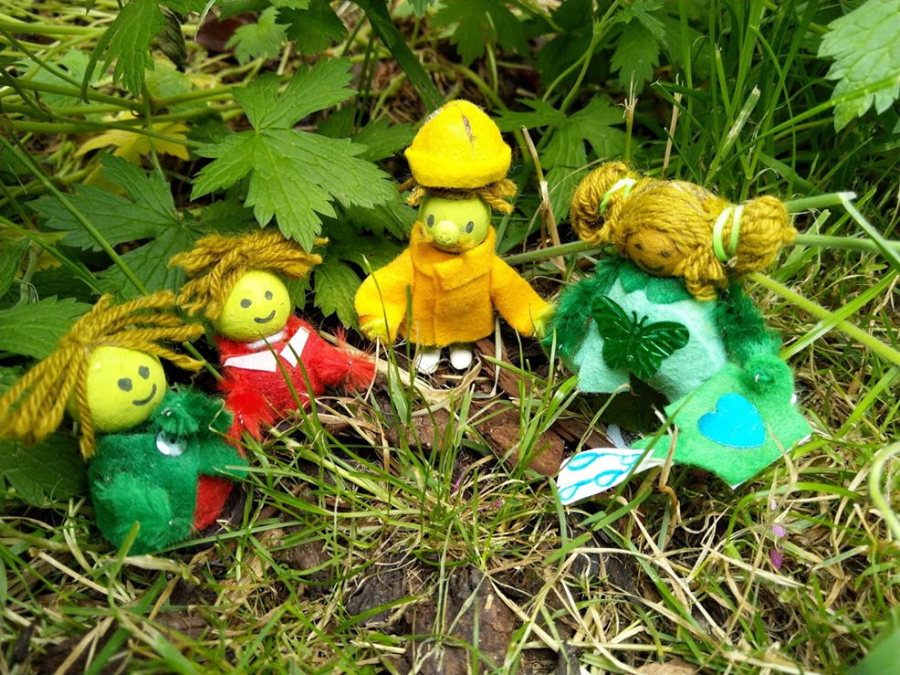
If you are making models you will need . . .
paper balls
little sticks
pipe cleaners
wool
felt and ribbon
buttons and shapes

Slide 29
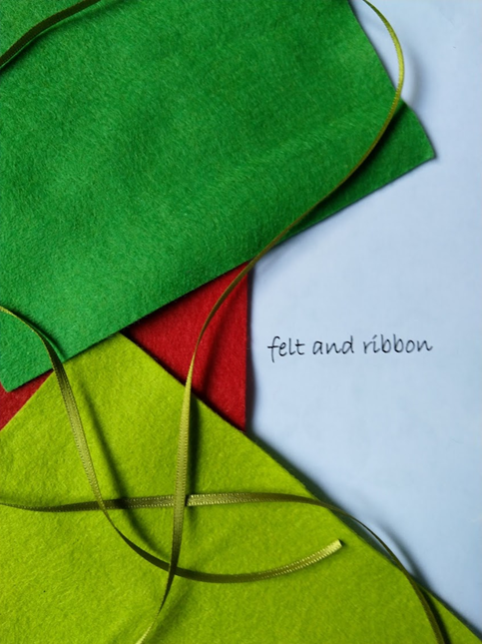
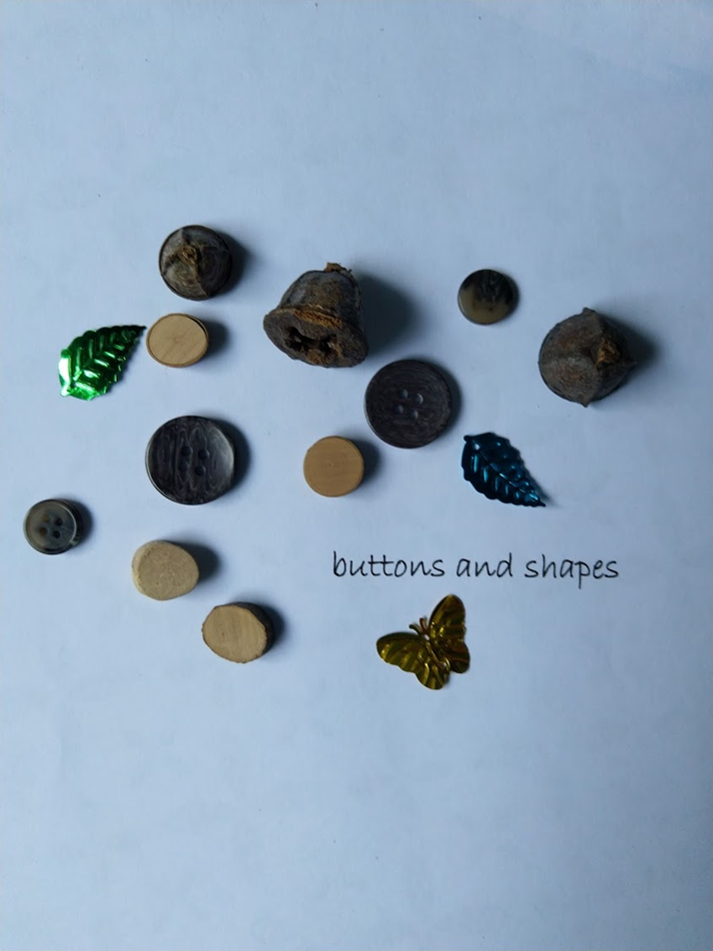
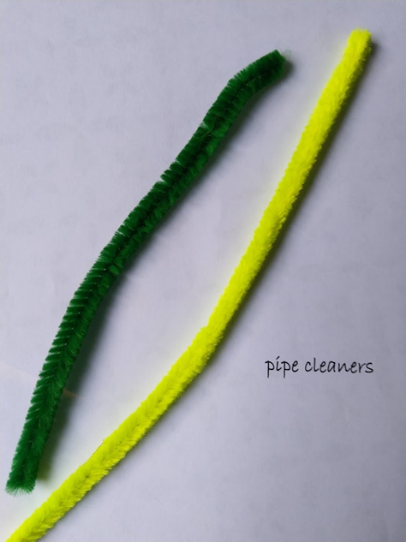
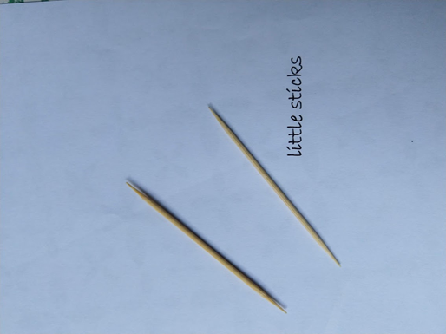
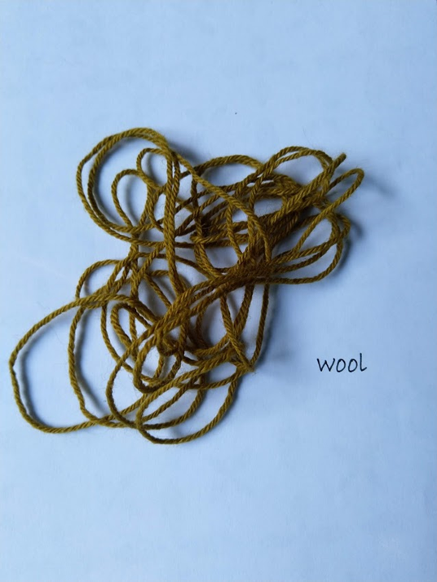
You will also need . . .
glue and playdough
scissors and paint
paper and card
and a black pen

Slide 30
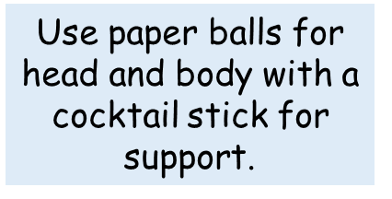
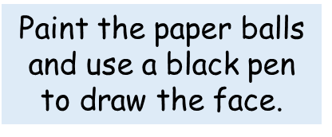
To make the people . . .

Slide 31
And then . . .
Use a pipe cleaner for arms and hands.
Use wool for hair, felt for clothes and a button or playdough for feet.

Slide 32
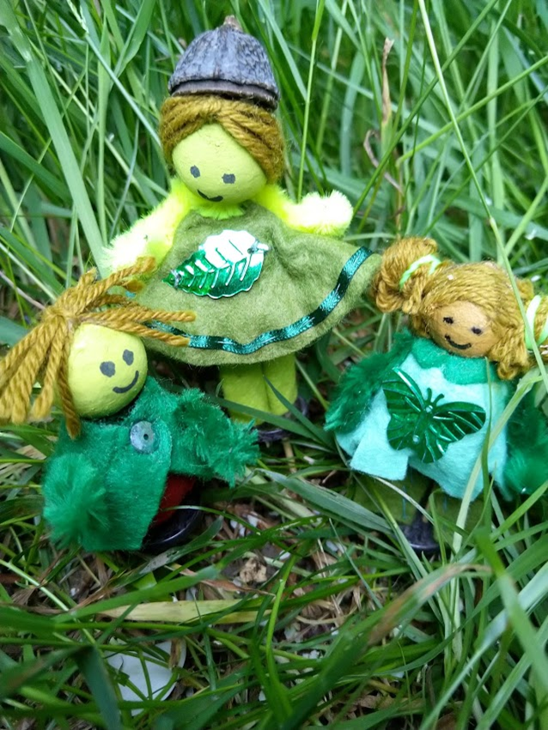
Enjoy your film-making!

